Slide 1
Digital payment methods
Data analyst specialist – DEPI final project

Slide 2
Contents
01
02
03
04
Data Preparation for Exploration
Making Data-Driven Decisions
Data Analysis to Answer Questions
Data Visualization in Tableau

Slide 3
01
Data Preparation for Exploration

Slide 4
How We preprocess Data for Exploration?
Insert Data
Clean Data
Edit Data
First, we get our data from
Kaggle website
Then, Insert new 500 rows
from different sources using SQL
we found 708*4 missing values
500 duplicated rows we drop it
We filling nan value
with specific values
(product category)
with mean
(product amount & transaction fee)
with mode
(location)
replace
UPI to unified payments interface
Round to 2 decimal places
product amount & transaction fee columns
concatenate
the data rows (4999+500)

Slide 5
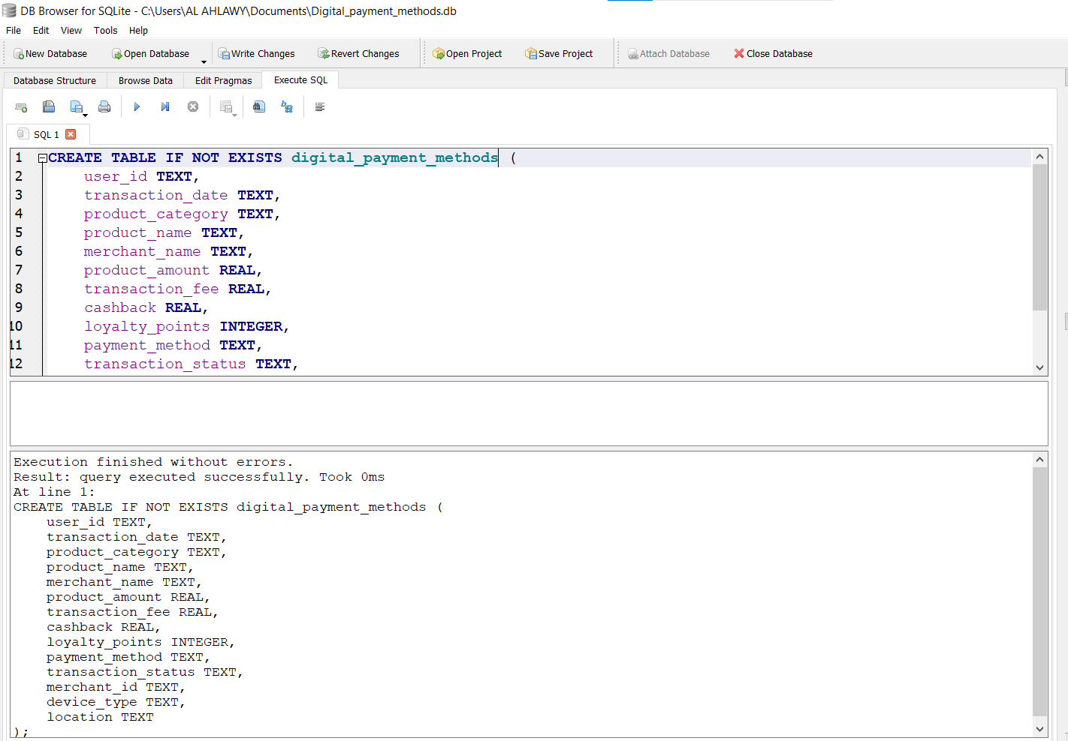
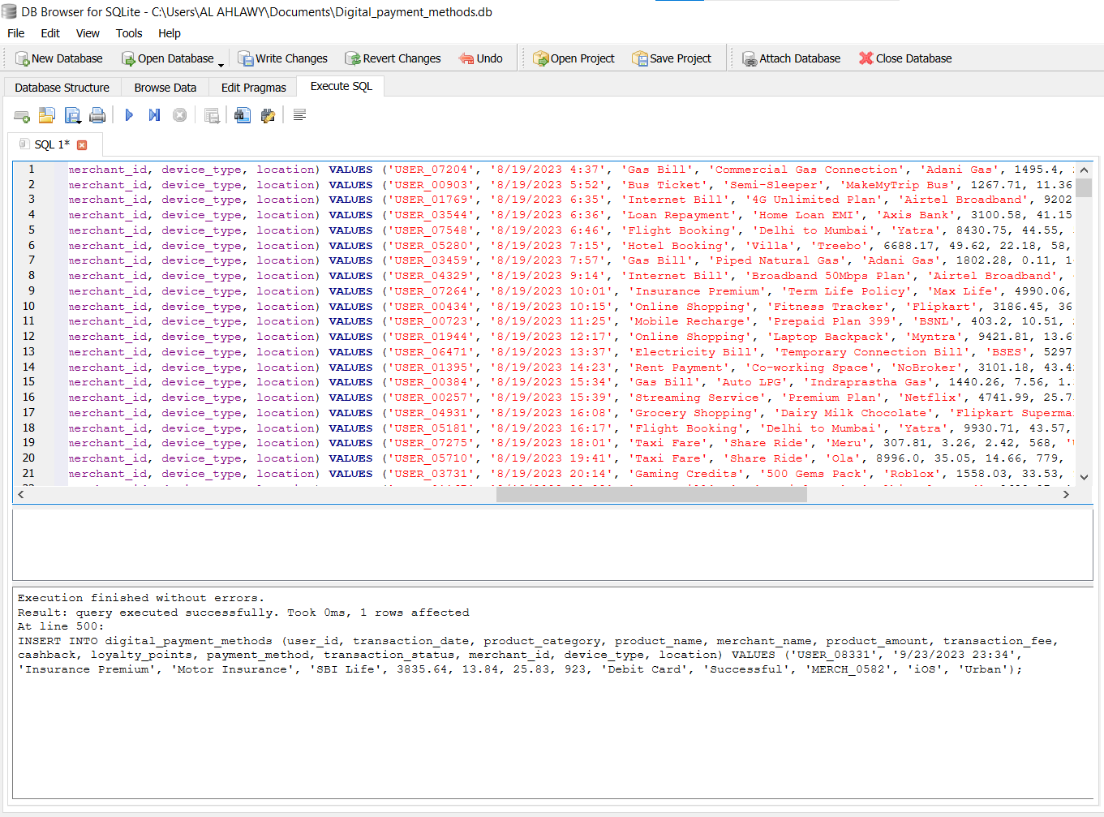
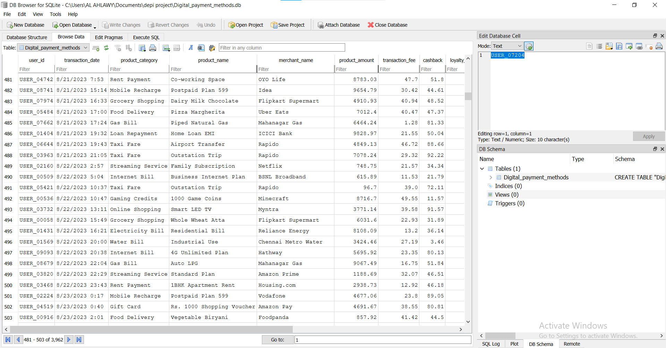


Process
Vénus
Mars
Vénus a un beau nom et est la deuxième planète à partir du Soleil
Malgré sa couleur rouge, Mars est en fait un endroit froid

Slide 6
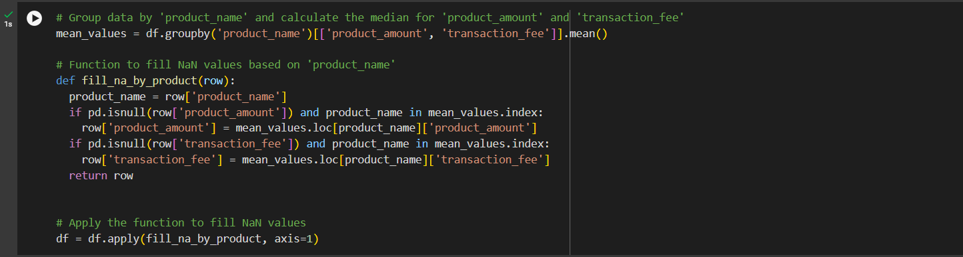
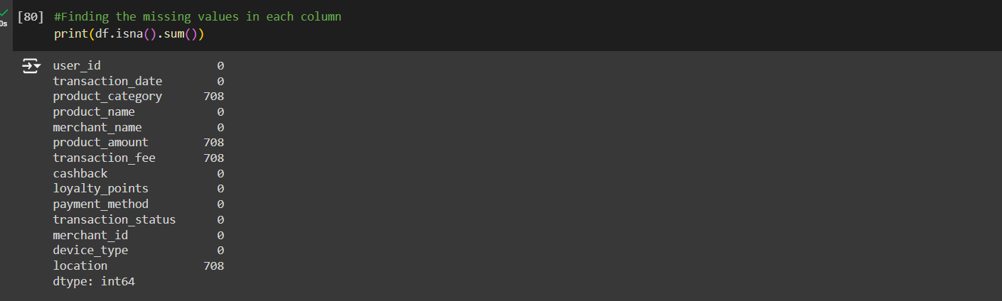
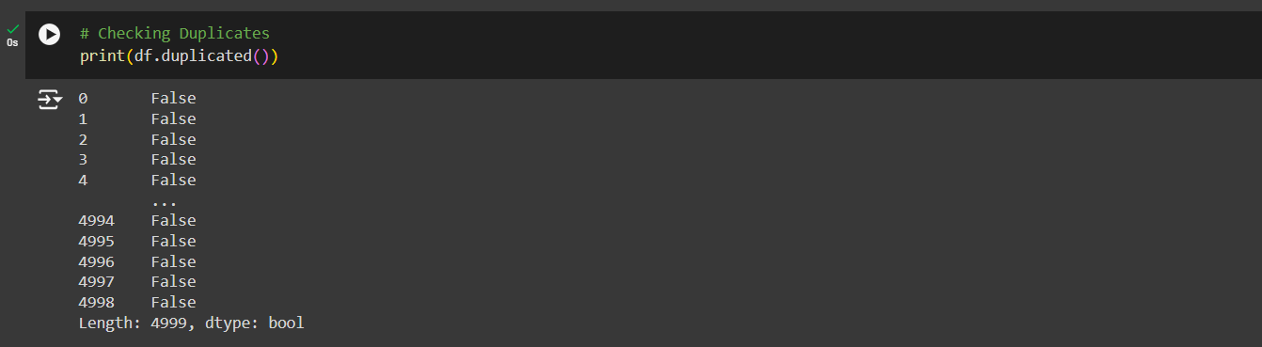
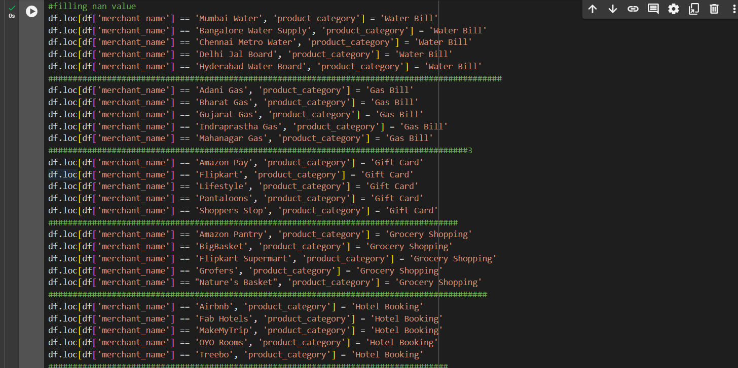
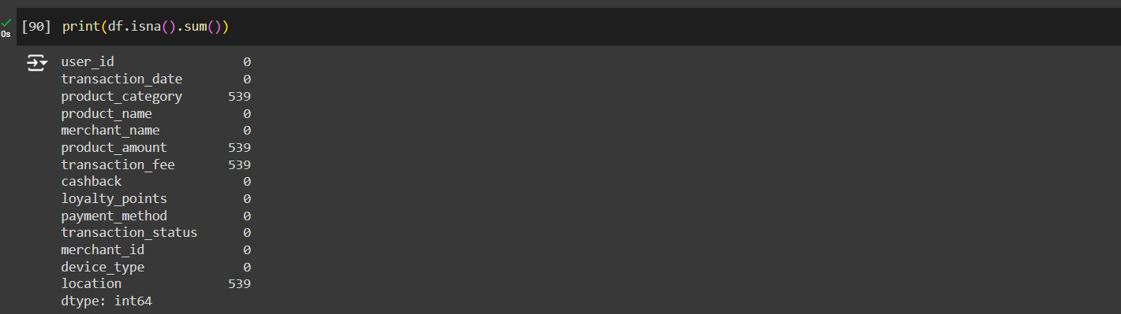
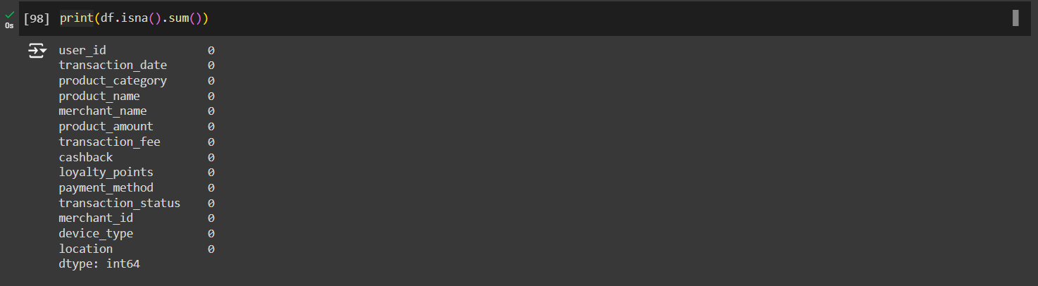

Process

Slide 7

Process

Slide 8
02
Data-Overview

Slide 9
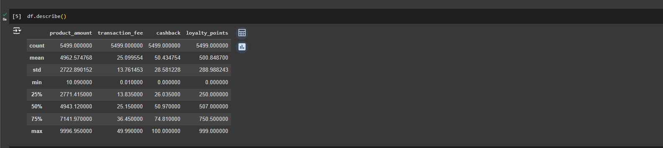
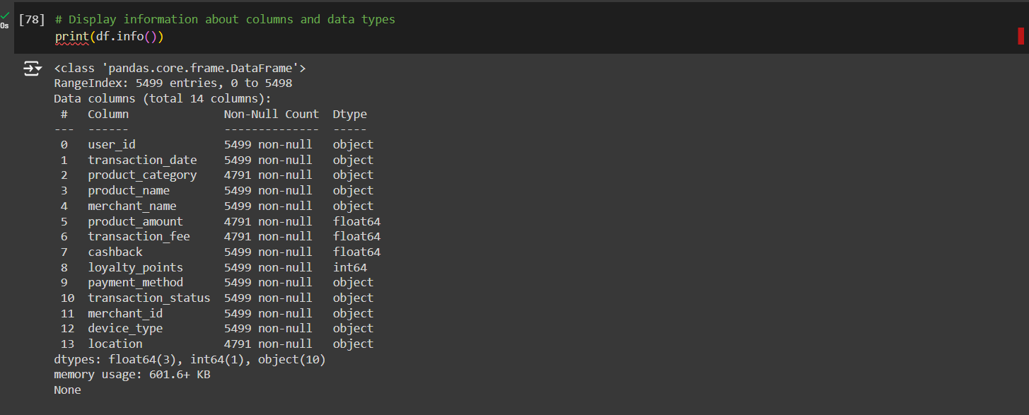
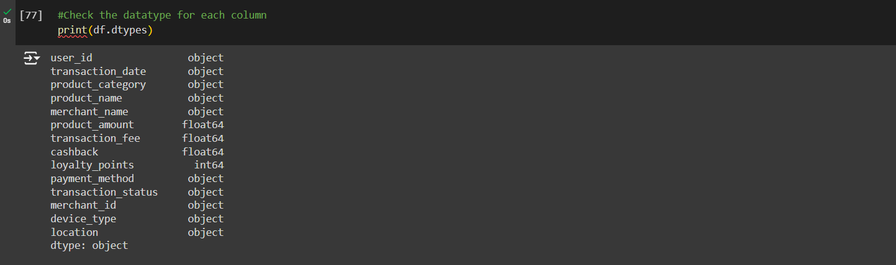
Data information
Data description
Column data type

Slide 10
"Why do we use pivot table to understand the data?
To Identifying calculate, summarize, and analyze data that lets you see comparisons, patterns, and trends in your data. “

Slide 11
Process

Slide 12
03
Data Visualization in Tableau

Slide 13
Now we will show how using tableau to create a Interactive dash board
Bulding Data source
Bulding Charts
We started to connect our csv file in tableau to begin our process
We build 5 charts and 6 cards to vizualize our data and get insghits
Bulding Dashbord
Now we have the last phase and how create our dashbaord
Plan the dashbard
Fixing the dashboard
Fixing colors
Fix texts and spacing
Refine charts
Create container structure put all charts toghter

Slide 14
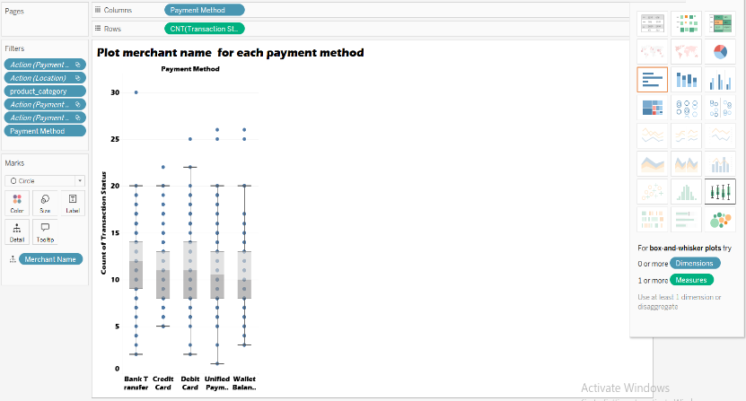
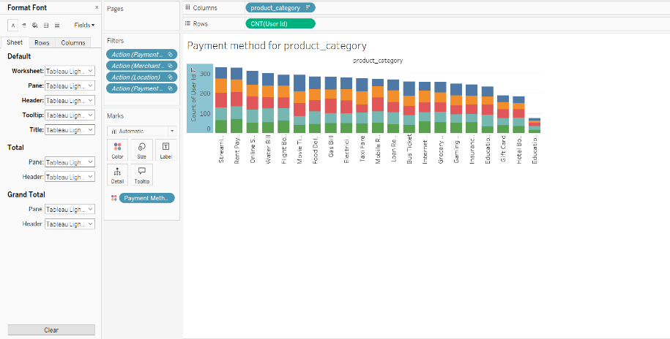
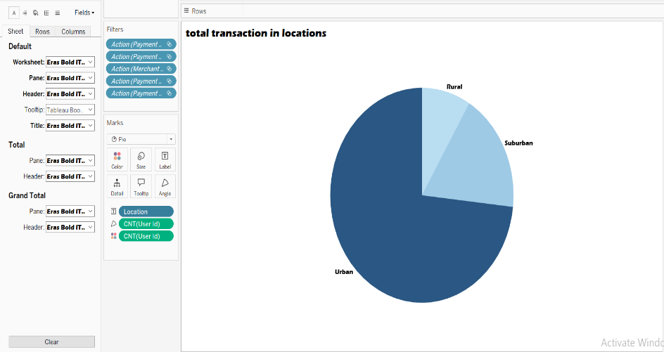
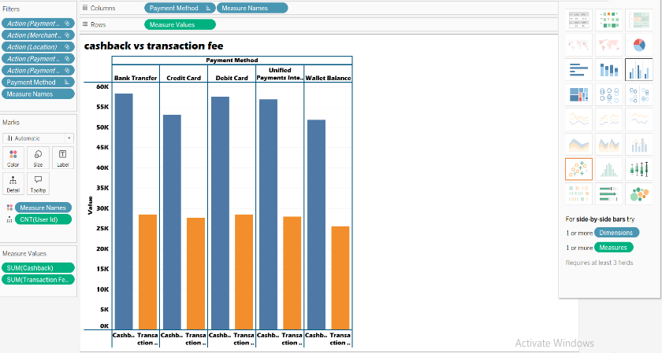
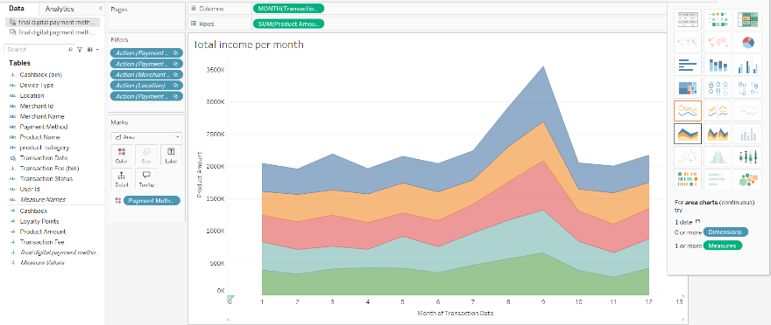

Slide 15
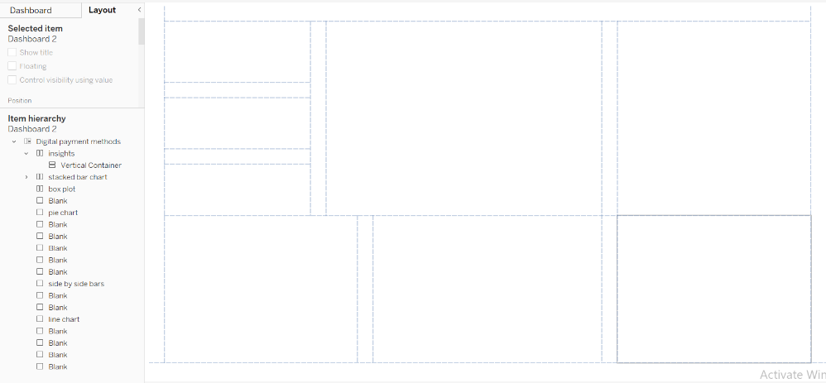
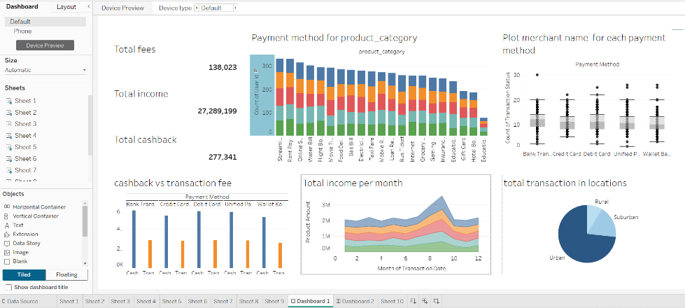
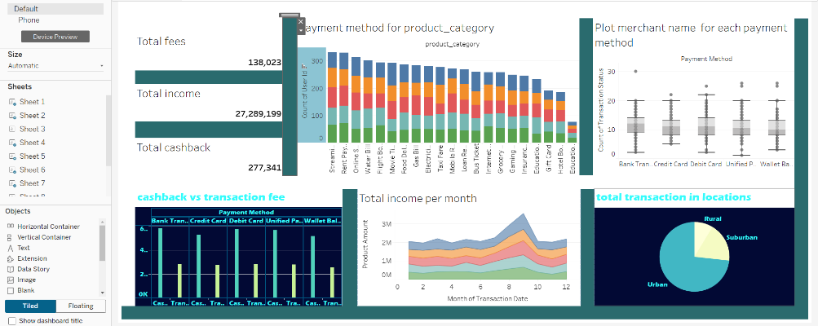

Slide 16
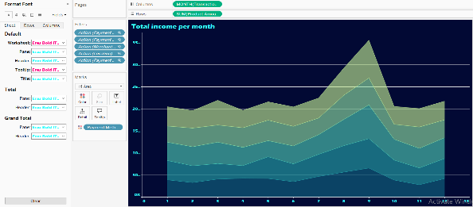
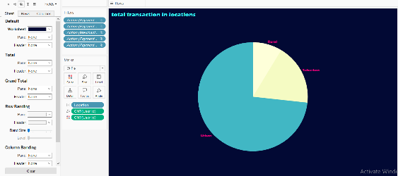
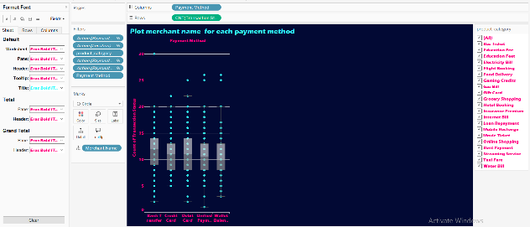
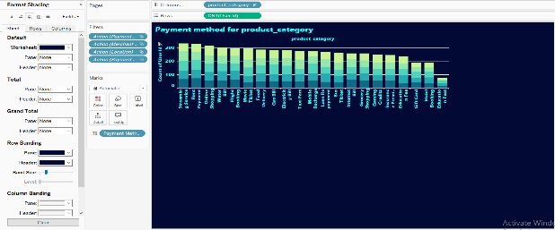
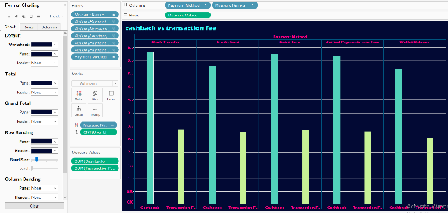

Slide 17
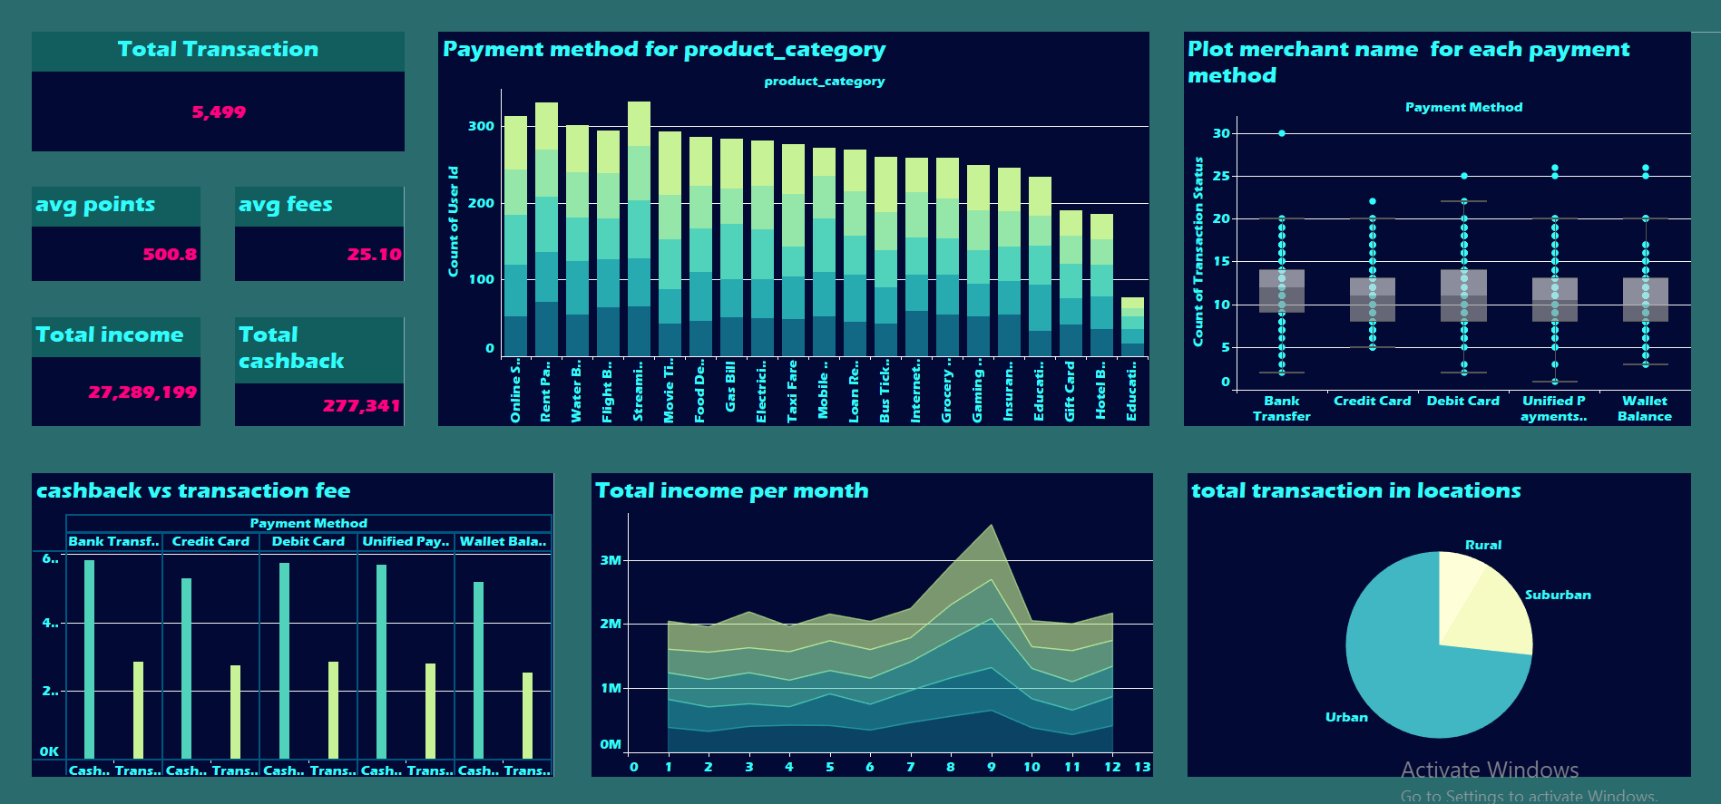

Slide 18
5.499
Number of total transaction

Slide 19
27.289.199
277.341
Total income
Total cash back
500.8
25.10
Average loyalty points
Average transaction fee

Slide 20
Séquence
First
Second
Third
box plot to identify the outliers of each payment method according to the merchant name
the side by side bars chart that compare between the cashback and transaction fees in each payment method
a pie chart show the total transaction according the location that identify the most category using the digital payments.
Fourth
Fifth
stacked bar chart shown the relation between some product category according the payment methods
the line area chart that shown the total income per month for each payment method

Slide 21
04
Data Analysis to Answer Questions

Slide 22
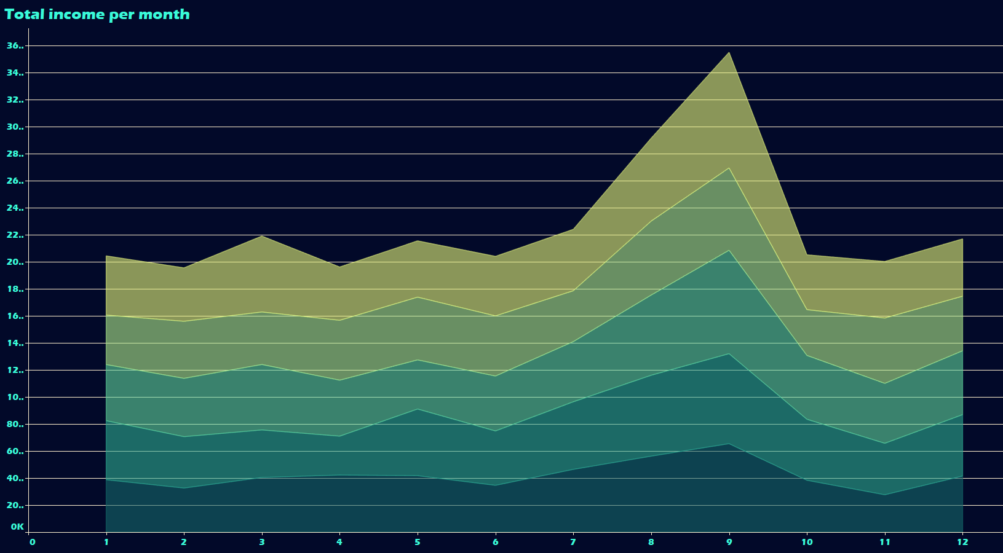
Which payment method is the most popular?
Answer
Bank Transfer is the most common payment method, suggesting that users prefer this method for digital payments over others like Debit Cards or UPI.
Insight
Bank Transfers are a dominant mode of payment, indicating user trust in traditional bank methods for digital transactions.

Slide 23
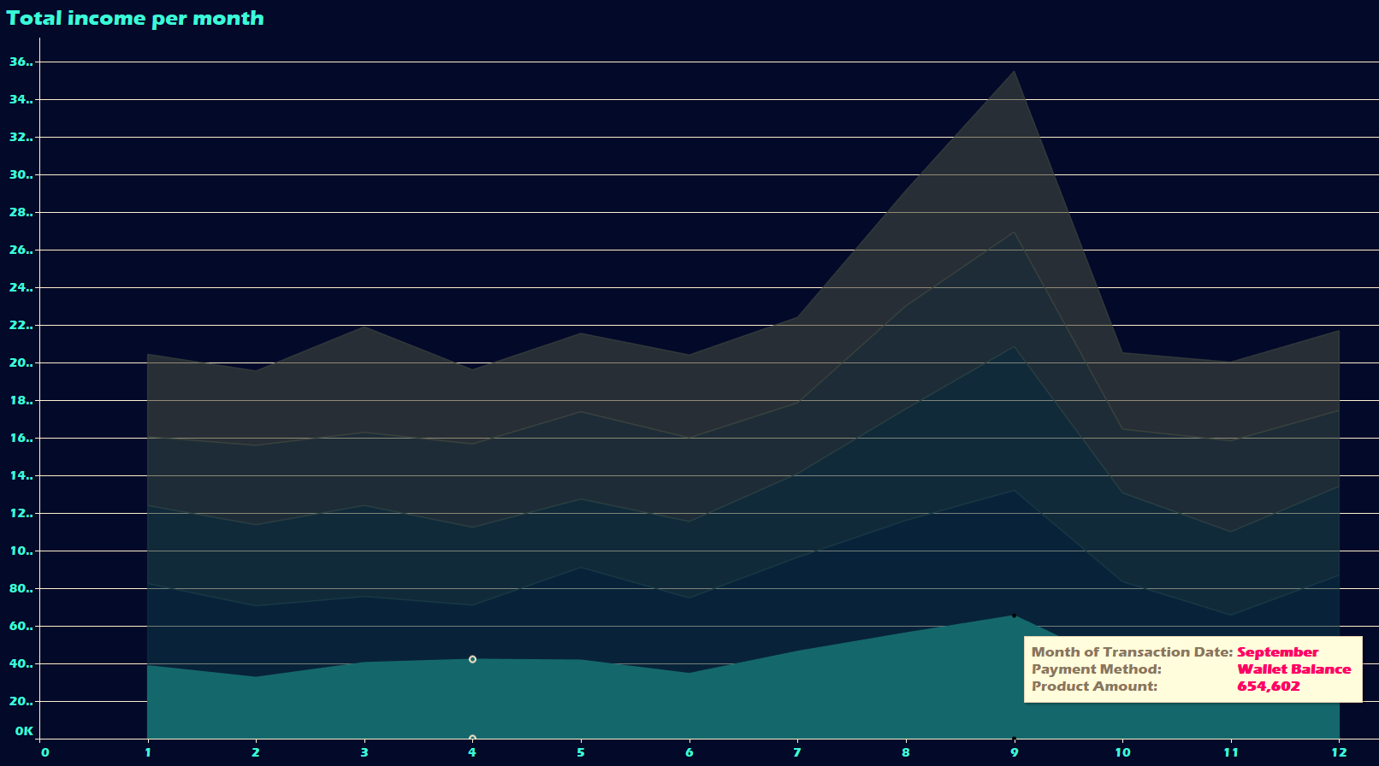
What is the least common payment method?
Answer
A closer look would reveal the least frequently used payment method, likely something more niche like mobile wallets.
Insight
Niche payment methods have less traction, perhaps due to lack of awareness or limited acceptance by merchants.

Slide 24
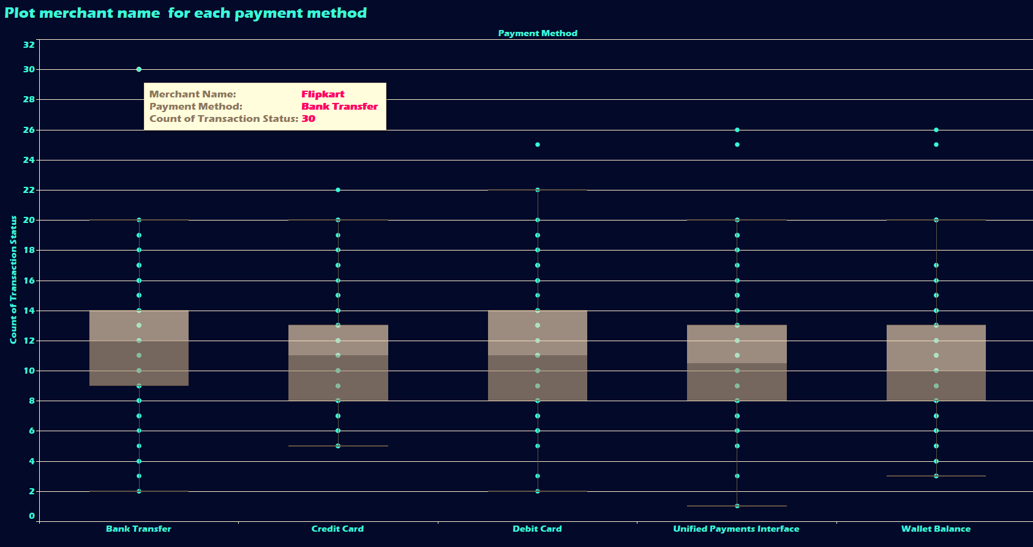
Which merchant has processed the most transactions?
Answer
Flipkart is the top merchant with the most transactions.
Insight
Travel-related services like fiipkart play a significant role in digital payments, showing the popularity of online bookings.

Slide 25
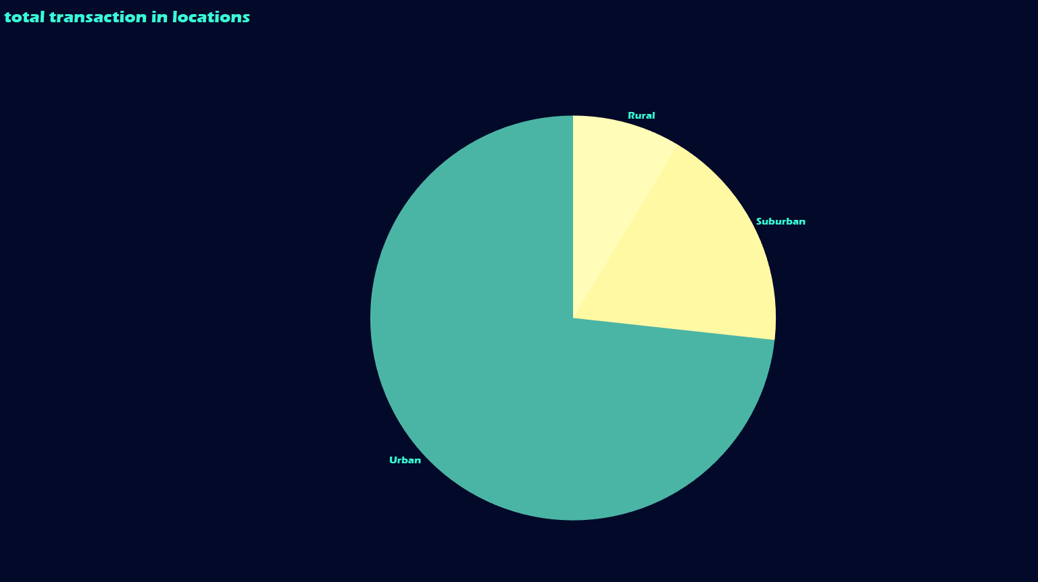
What are the most common transaction locations?
Answer
Urban areas are the predominant locations for transactions
Insight
Digital payment methods are widely adopted in urban regions, possibly due to better access to technology and internet infrastructure.

Slide 26
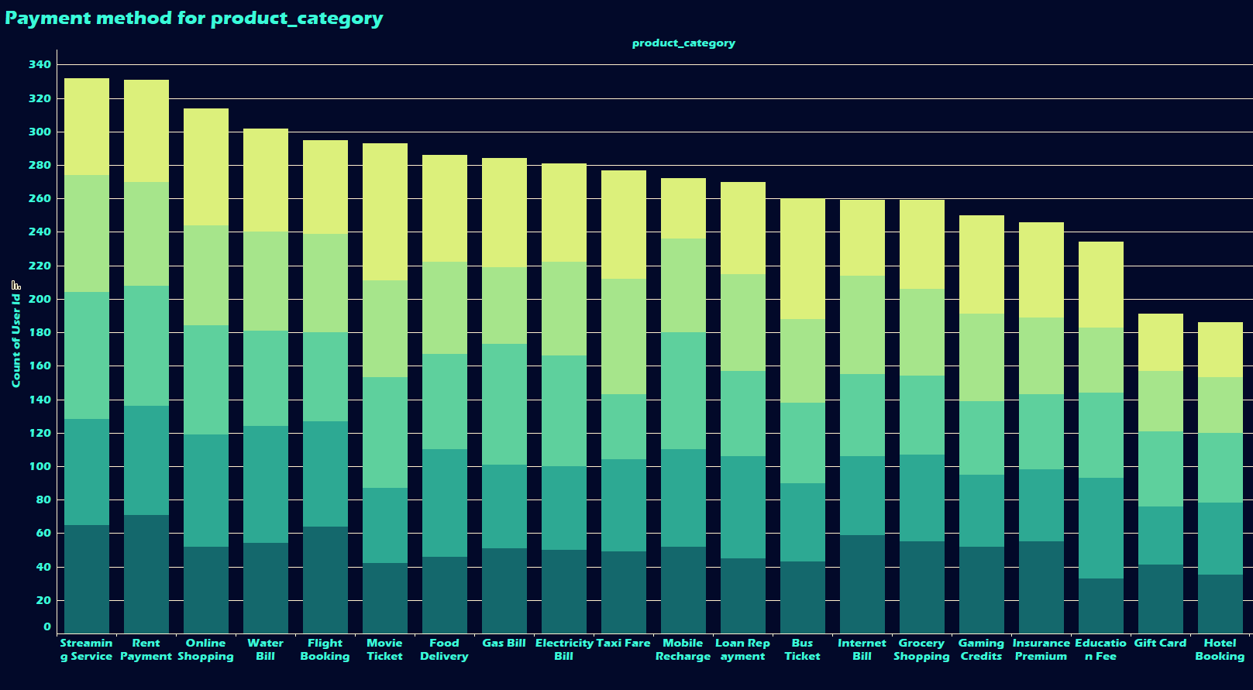
What is the most common merchant category by the number of transactions?
Answer
From the product categories, merchants in services like Streaming or Internet Bills are likely to dominate.
Insghit
Service-based industries, particularly related to entertainment and utilities, are key drivers of digital payments.

Slide 27
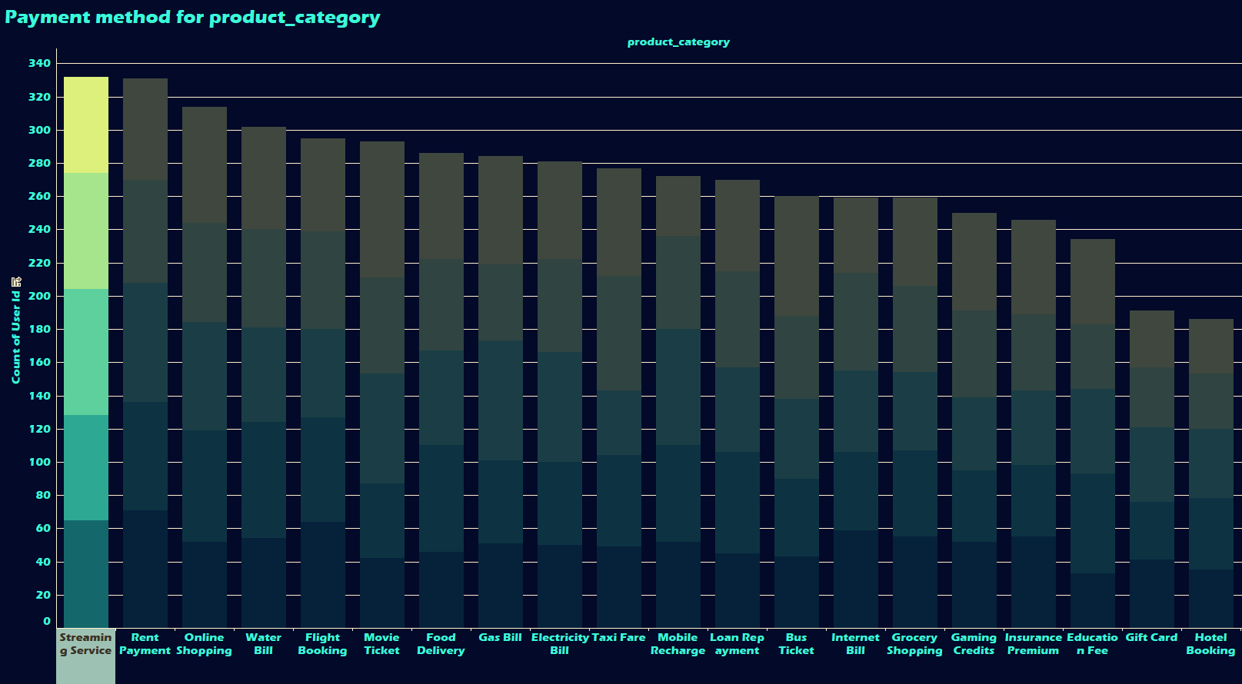
Which product category is the most frequently purchased?
Answer
Streaming Service is the most frequently purchased category
Insight
The frequent purchase of streaming services indicates a trend toward digital entertainment consumption, reflecting broader market shifts.

Slide 28
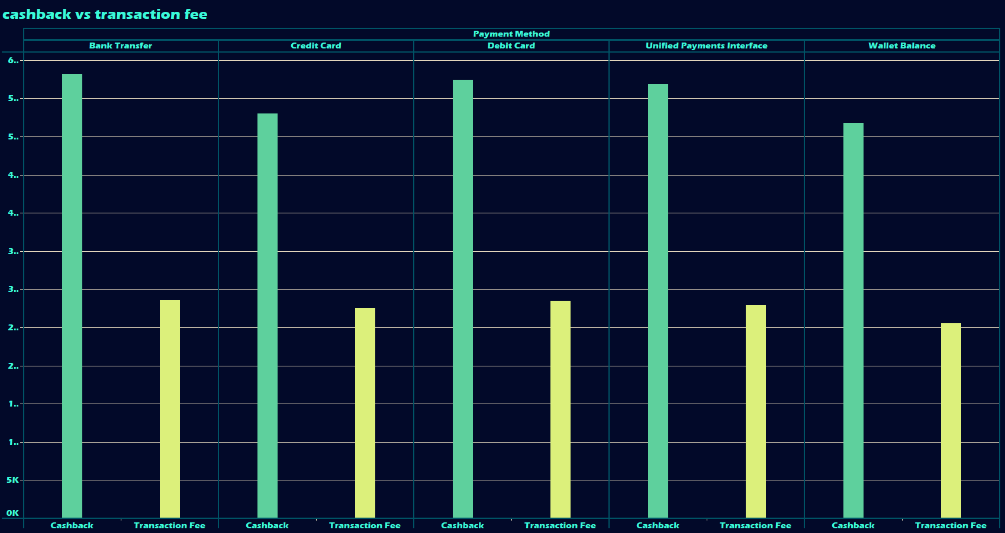
Is there a correlation between transaction fees and cashback?
Answer
We could analyze whether higher fees are associated with higher cashback amounts.
Insghit
it may indicate that platforms offset higher fees with higher rewards, balancing costs for users.

Slide 29
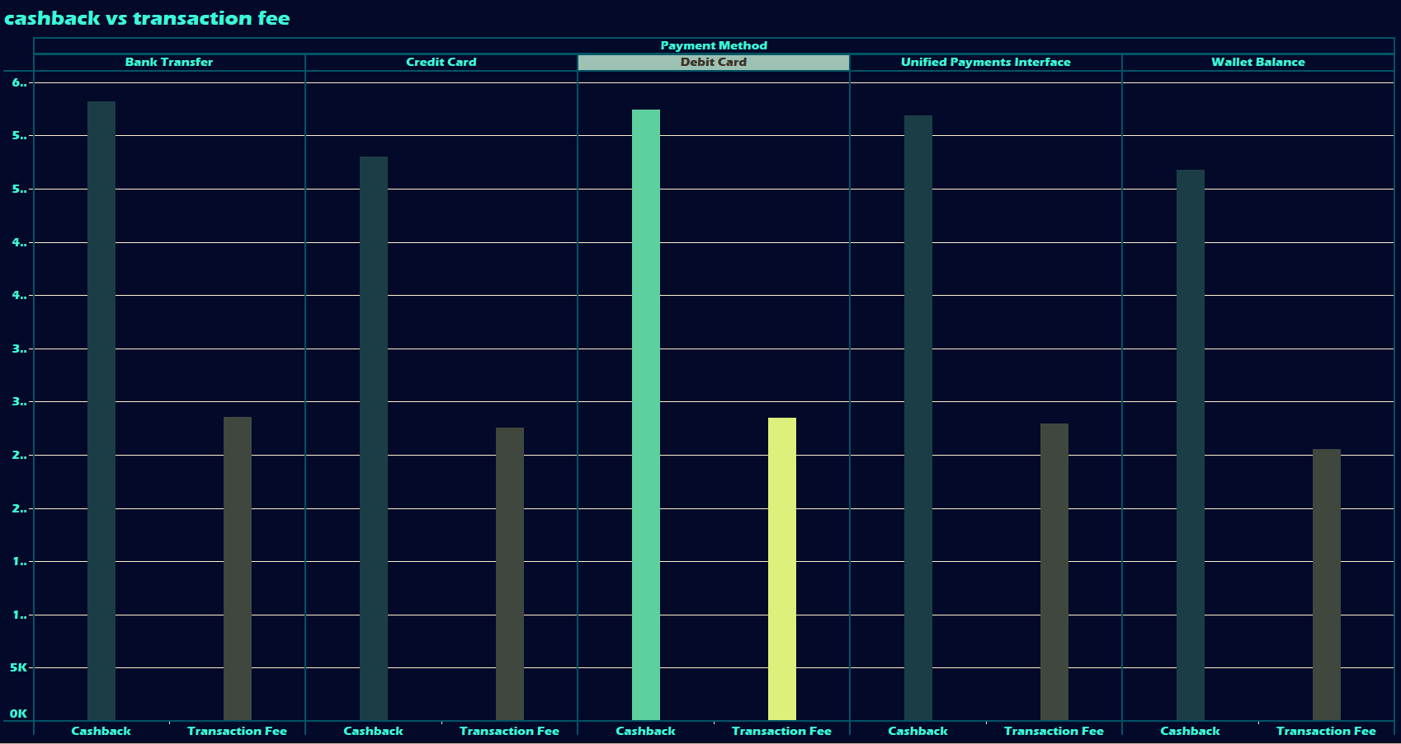
What is the distribution of cashback across different payment methods?
Answer
Payment methods like UPI and Debit Cards might offer higher cashback incentives compared to others.
Insghit
Some payment methods are favored with higher cashback rewards, potentially encouraging users to prefer certain payment options.

Slide 30
Prioritize Popular Payment Methods
Porblem statement
chart
Recmondation
The shift to digital payment methods requires businesses and banks to adapt quickly to changing consumer preferences.
Line
Businesses should ensure that Bank Transfer options are seamlessly integrated across their platforms. Banks could enhance the user experience of this payment method by offering features like instant payments or lower fees for digital transactions.
Stacked bar
Outcome
Side by side bar
This will enhance user satisfaction and retention, encouraging repeat usage and driving market performance through greater customer loyalty.
Pie

Slide 31
Monitor and Adapt to Emerging Payment Trends
Porblem statement
chart
Recmondation
User engagement and retention are crucial for maintaining a competitive edge in the digital payment market.
Line
Businesses and banks should continuously monitor emerging payment methods and trends, integrating them quickly into their systems. Offering early adopter incentives for new payment methods can help accelerate their adoption.
Side by side bar
Outcome
Stacked bar
Staying ahead of the curve by adopting new payment technologies will ensure competitiveness in the fast-evolving digital payment landscape.
Pie

Slide 32
Maximize Cashback and Loyalty Incentives
Porblem statement
chart
Recmondation
There is a need to understand how different payment methods impact customer satisfaction, transaction efficiency, and overall market performance.
Side by side bar
Businesses should expand cashback and loyalty programs, particularly for high-transaction categories like flight bookings. Offering personalized cashback or bonus loyalty points for frequent users can keep customers engaged.
Stacked bar
Outcome
Line
This will enhance transaction efficiency and cater to a majority of users, ensuring faster adoption of digital services.
Pie

Slide 33
Increase Adoption of Niche Payment Methods
Porblem statement
chart
Recmondation
Identifying key factors driving the adoption of specific payment methods can help stakeholders stay competitive in a rapidly evolving market.
Stacked bar
Businesses and banks should promote lesser-used payment methods by offering higher cashback or exclusive rewards for transactions using these methods. Providing educational content or tutorials can also help users understand the benefits.
Side by side bar
Outcome
Line
This will diversify payment method usage, allowing stakeholders to better prepare for a future where niche methods gain popularity
Pie

Slide 34
Enhance Security Features without Compromising Convenience
Porblem statement
chart
Recmondation
Enhancing transaction efficiency and user experience is key to staying competitive.
Stacked bar
Implement advanced security features like two-factor authentication or biometric verification for high-value transactions, while ensuring they are not cumbersome for users. Offering fraud protection for all payment methods could also increase trust.
Side by side bar
Outcome
Line
Users will feel more secure using digital payments, which could lead to an increase in adoption across all transaction sizes.
Pie

Slide 35
Expand Awareness and Infrastructure in Rural Regions
Porblem statement
chart
Recmondation
What can banks and payment platforms do to increase the adoption of digital payments in rural areas?
Pie
Banks should partner with local businesses and governments to improve digital infrastructure, such as mobile connectivity and internet access. Educating users about the benefits of digital payments through campaigns, especially in rural regions, will boost adoption.
Side by side bar
Outcome
Stacked bar
Expanding digital payment infrastructure and awareness in rural areas will increase overall transaction volume and broaden the user base.
Line

Slide 36
Thank You

